Slide 1
Git Workflow
Anuranjan Srivastava(Codersaty)

Slide 2

Introduction
Before Git tracks a change, it goes through a long chain of operations and tasks.
Many of these tasks are user controlled, and are required for changes to be tracked correctly.

Slide 3
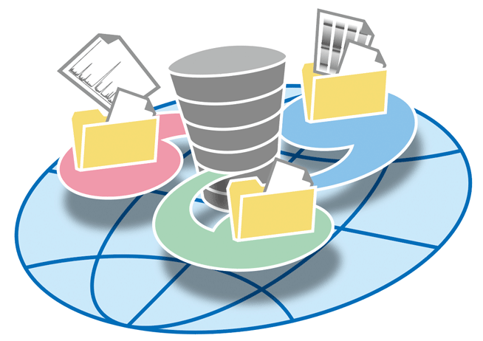
Repositories
Repositories, usually called ‘repos’, store the full history and source control of a project.
They can either be hosted locally, or on a shared server, such as GitHub.
Most repositories are stored on GitHub, while core contributors make copies of the repository on their machine and update the repository using the push/pull system.
Any repository stored somewhere other than locally is called a ‘remote repository’.

Slide 4
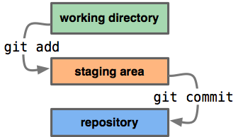
Repos vs Directories
Repositories are timelines of the entire project, including all
Directories, or ‘working directories’ are projects at their current state in time.
Any local directory interacting with a repository is technically a repository itself, however, it is better to call these directories ‘local repositories’, as they are instances of a remote repository.

Slide 5
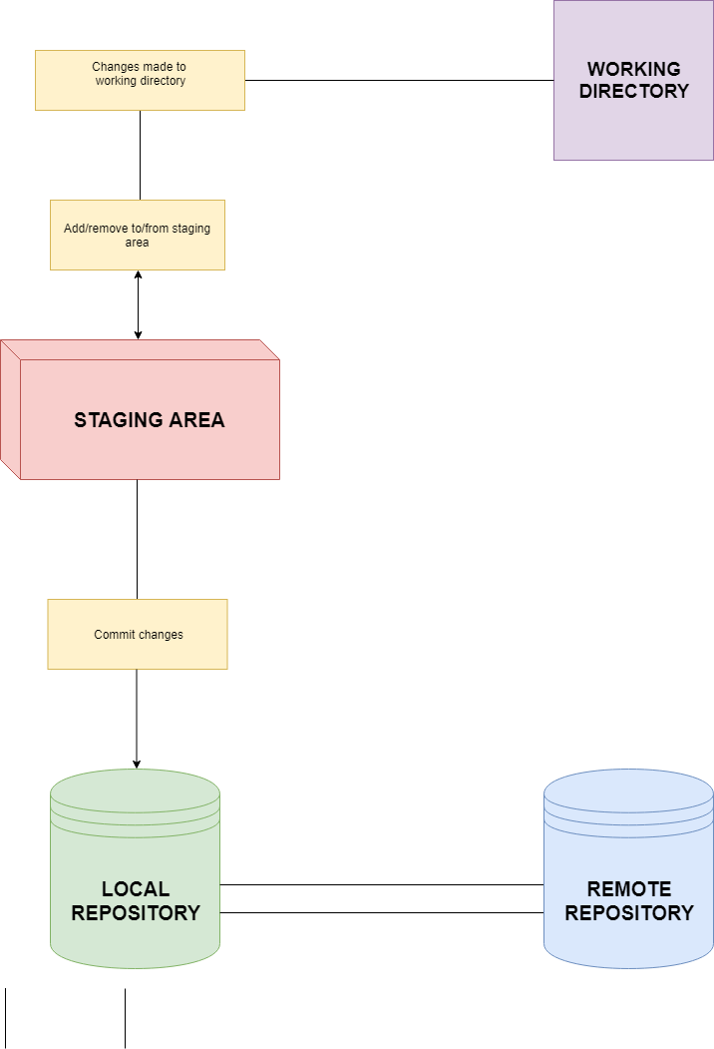
Workflow Diagram
This diagram shows a little bit about how the basic Git workflow process works
The staging area is the bundle of all the modifications to the project that are going to be committed.
A ‘commit’ is similar to taking a snapshot of the current state of the project, then storing it on a timeline.

